Slide 1
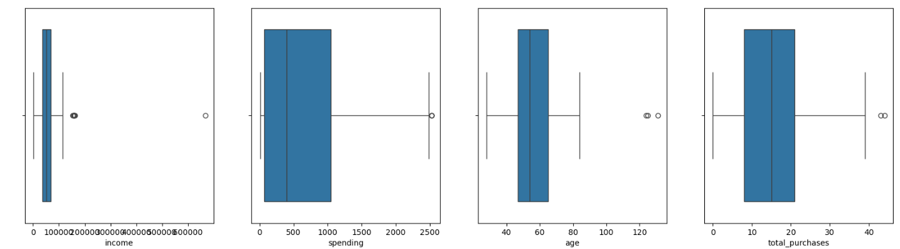
box plots for numerical variables (income, spending, age, and total purchases) to understand their distributions

Slide 2
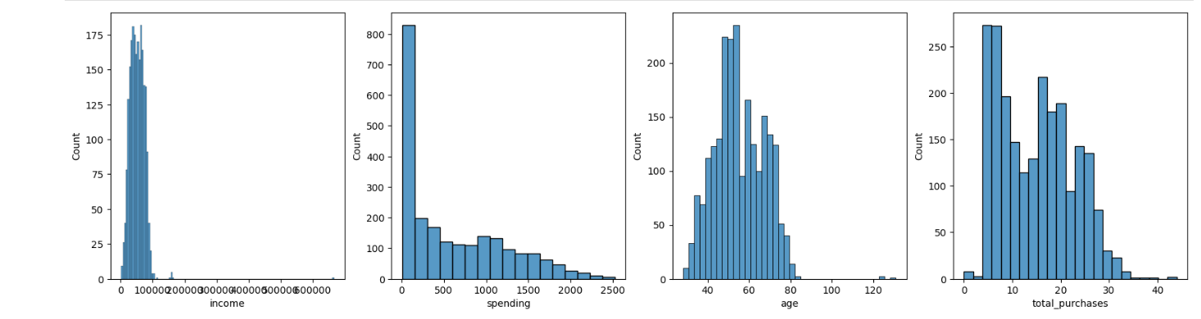
histograms for numerical variables (income, spending, age, and total purchases) to understand their distributions

Slide 3
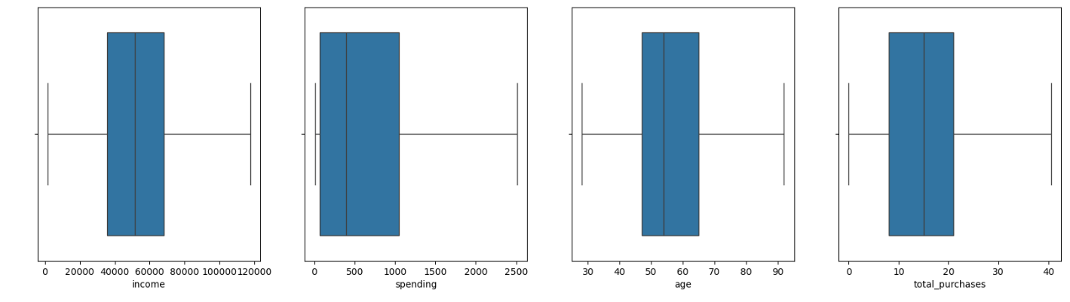
box plots for numerical variables (income, spending, age, and total purchases) After Removing The outliers

Slide 4
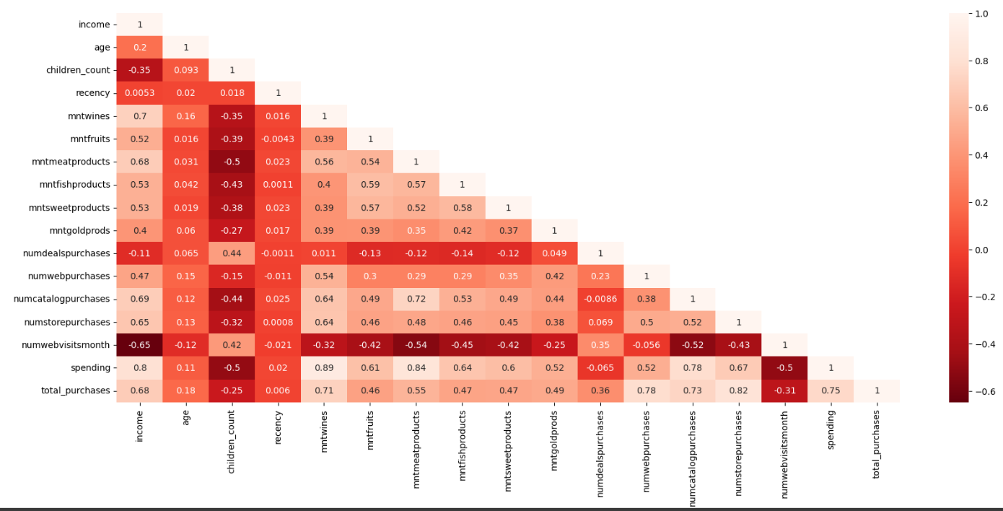
Visualization of Correlation Between Subset of Variables Using Heatmap

Slide 5
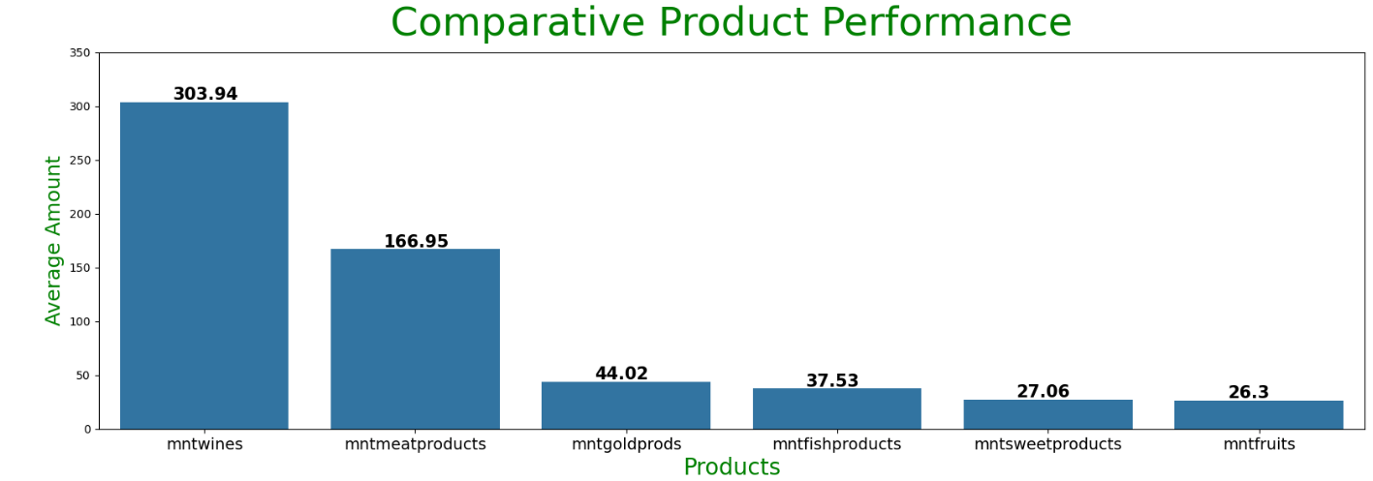
Visualize the performance of products using a bar plot

Slide 6
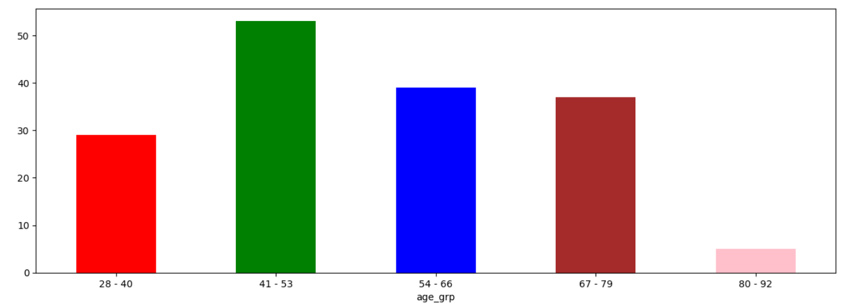
Visualizing the relationship between age and campaign acceptance rate using a bar plot

Slide 7
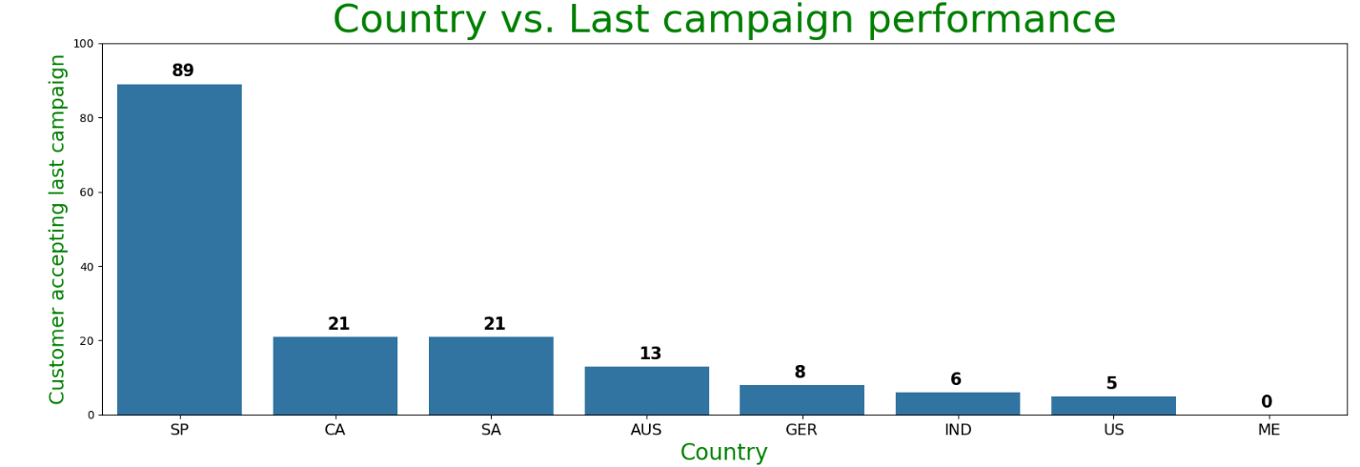
Determination of the country with the most customers who accepted the last campaign using a bar plot

Slide 8
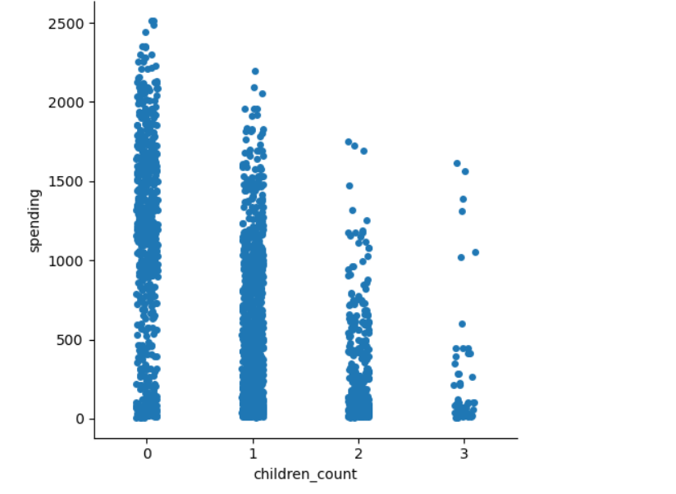
Visualization of the relationship between children and spending using a strip plot

Slide 9
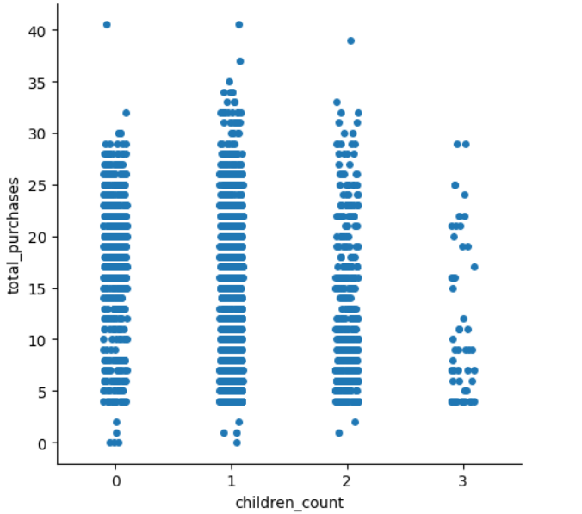
Visualization of the relationship between children and Total Purchase using a Cat plot

Slide 10
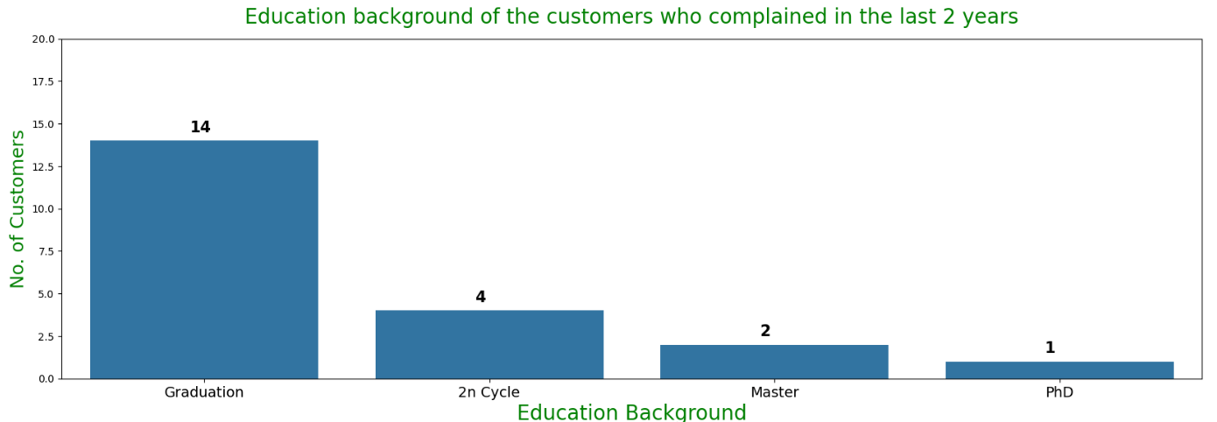
Visualization of the education background of customers who complained in the last two years using a bar plot

Slide 11
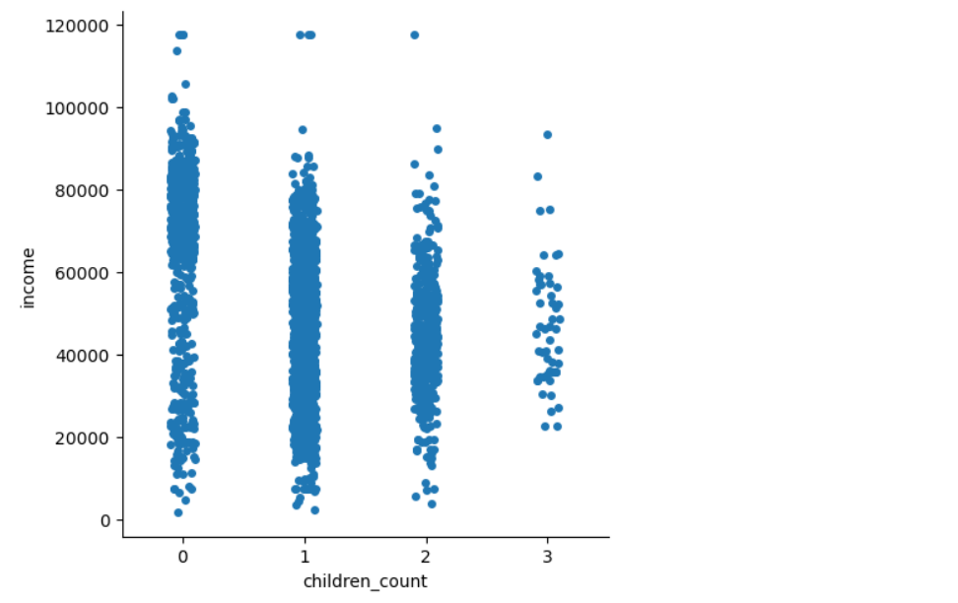
Visualization of the relationship between income and Children using a catplot

Slide 12
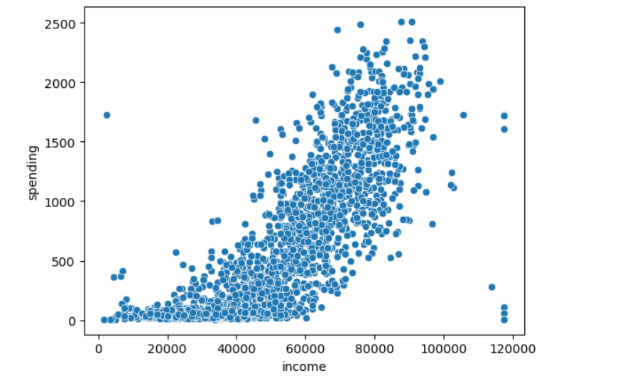
Visualization of the relationship between income and spending using a scatter plot

Slide 13
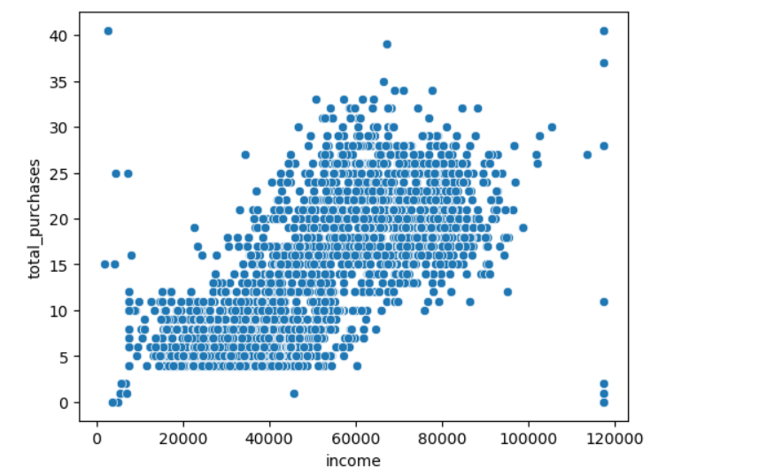
Visualization of the relationship between
Total purchase and income using scatterplot

